Slide 1
Notes:
Note to Teacher:
This PowerPoint presentation should be used in Slideshow View to display animated sequences.

Slide 2
7.0
Geographical Skills:
Ordnance Survey Maps
Learning Intentions
You will be able to:
Use and interpret Ordnance Survey Maps.

Slide 3
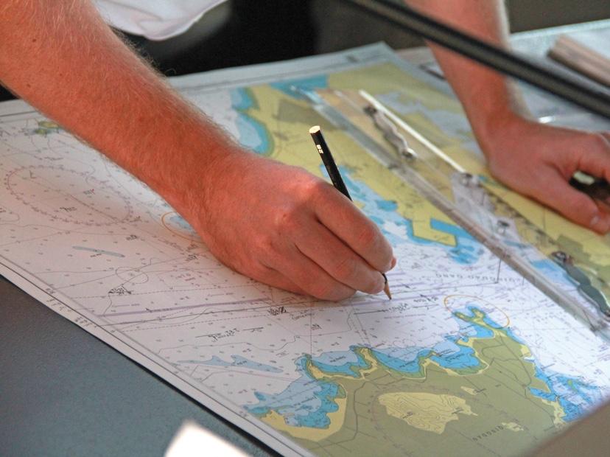

7.1
Ordnance Survey Maps
A map is a scaled-down drawing or plan of all or part of the earth’s surface.
Fun Fact!
Cartography is the study of maps and map-making.
Someone who makes maps is called a cartographer.

Slide 4
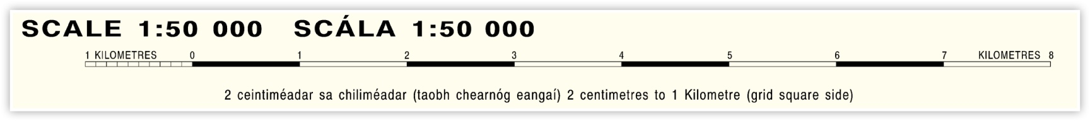
7.1
Ordnance Survey Maps
What is Scale?
Scale is the relationship between a distance on a map and its corresponding distance on the ground.
On an Ordnance Survey (OS) map, the same scale can be shown in three different ways:
1
3
2
1
Scale is given as a ratio. The ratio 1:50 000 means that any one unit of measurement on the map corresponds to 50 000 similar units on the ground.

Slide 5
7.1
Ordnance Survey Maps
What is Scale?
Scale is the relationship between a distance on a map and its corresponding distance on the ground.
On an Ordnance Survey (OS) map, the same scale can be shown in three different ways:
1
3
2
2
Statement of Scale simply states what the scale is (in this case, it is 2 cm to 1 km).

Slide 6
7.1
Ordnance Survey Maps
What is Scale?
Scale is the relationship between a distance on a map and its corresponding distance on the ground.
On an Ordnance Survey (OS) map, the same scale can be shown in three different ways:
1
3
2
3
Linear Scale is a ruled line divided into kilometres and parts of a kilometre (or into miles and parts of a mile). It allows us to measure distance directly from the map.

Slide 7
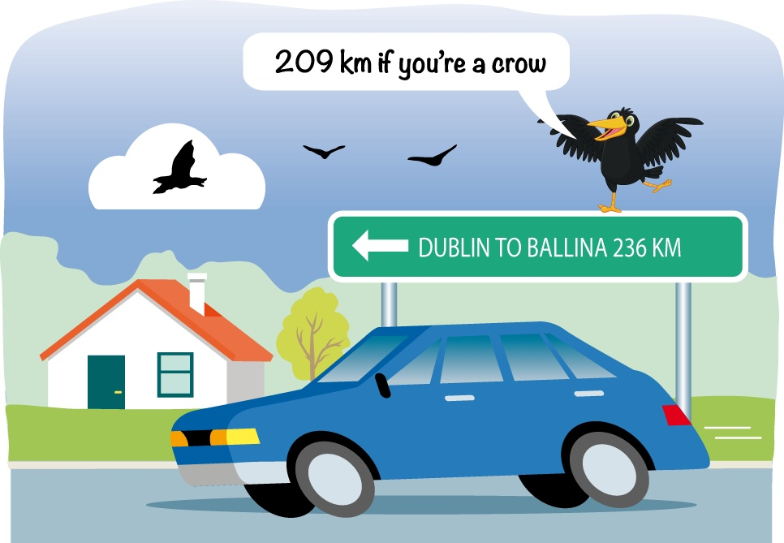
7.2
How to Measure Distances on
a Map
Straight Line Distances
The shortest distance between any two points is the straight line distance, or ‘as the crow flies’.

Slide 8
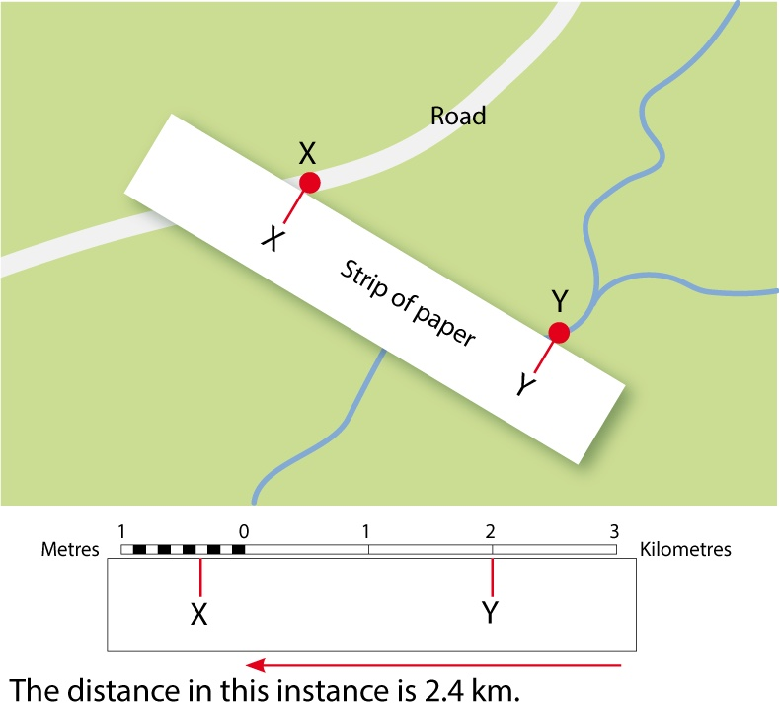
7.2
How to Measure Distances on
a Map
Calculating a Straight Line Distance
1
1
2
Place a straight edge of paper on the map so that it passes through the two points you wish to measure.
3

Slide 9
7.2
How to Measure Distances on
a Map
Calculating a Straight Line Distance
1
2
2
Mark the edge of the paper where the first point and last point touch it.
3

Slide 10
7.2
How to Measure Distances on
a Map
Calculating a Straight Line Distance
1
3
2
Place the edge of the paper on the map’s linear scale and measure precisely the distance between the two marks.
3

Slide 11
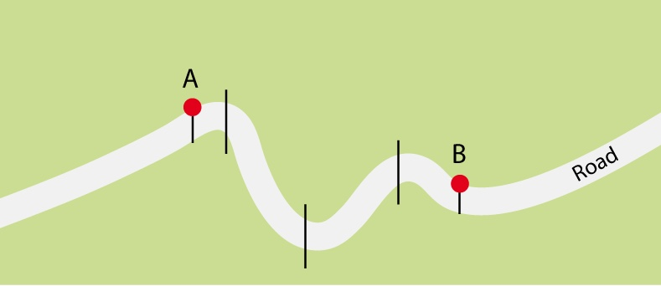
7.2
How to Measure Distances on
a Map
Measuring Curved Line Distances
Curved line distances on an OS map take the form of roads, rivers or railway lines.
1
1
Divide the road into a number of straight line segments.

Slide 12
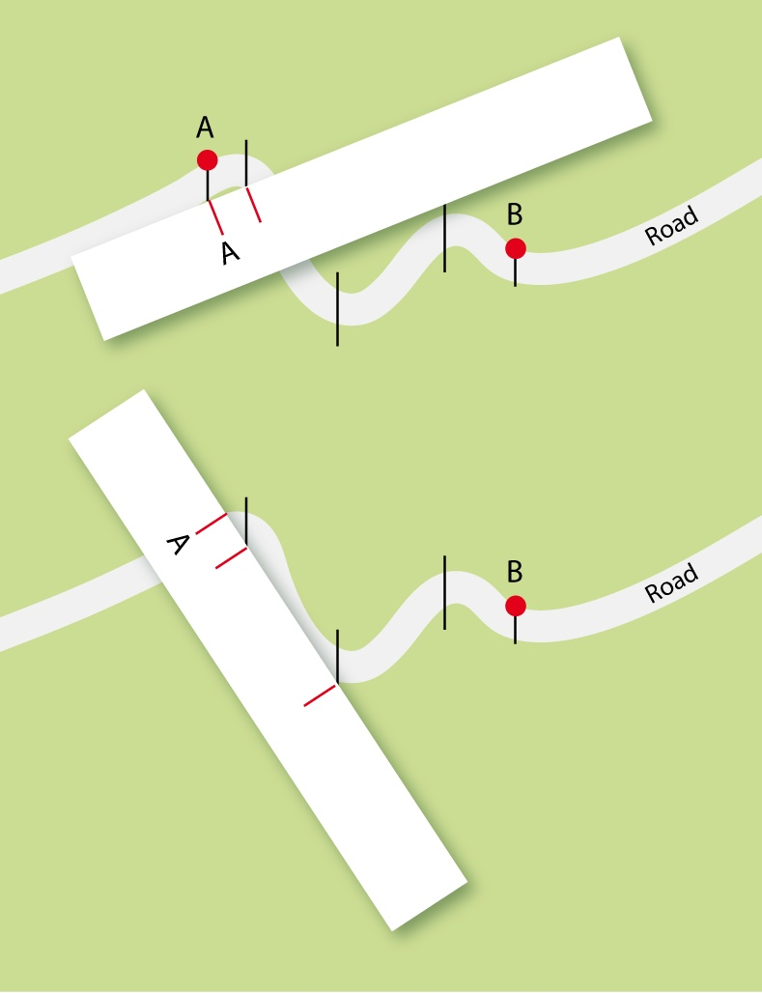
7.2
How to Measure Distances on
a Map
Measuring Curved Line Distances
2
2
Using a straight edge of a piece of paper, lay it on the starting point of the distance you wish to measure. Mark it on the paper.
Mark each straight line segment along your piece of paper.
You now have a number of straight line distances, which are easier to measure.

Slide 13
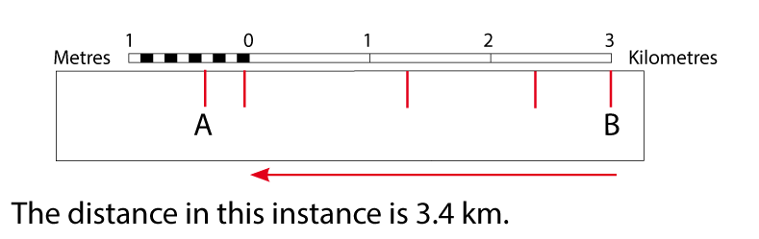
7.2
How to Measure Distances on
a Map
Measuring Curved Line Distances
3
3
Place the edge of the paper on the linear scale and measure the distance of your curved road. Remember to start measuring from 0.

Slide 14
7.2
How to Measure Distances on
a Map
Calculating Area on Maps
Ordnance Survey maps with a scale of 1cm:50 000cm have boxes called grid squares. The side of a full grid square measures one kilometre (km).
Calculate a regular-shaped area
This method works for any regular-shaped (rectangular) area you wish to measure.
1. Count the number of grid squares across the base of the area you wish to measure.
2. Count the number of squares going up the side of the area.
3. Multiply both numbers. This gives you your answer in square kilometres (sq km/km²).

Slide 15
7.2
How to Measure Distances on
a Map
Calculating Area on Maps
Ordnance Survey maps with a scale of 1cm:50 000cm have boxes called grid squares. The side of a full grid square measures one kilometre (km).
Calculate an irregular-shaped area
The total area of each grid square on a 1:50 000 map is 1 km².
To calculate the approximate area of any irregular-shaped feature, e.g. a lake, a bay, a forest, use this method.
Tick off and count all the squares that are at least half-filled by the feature. This number will represent the approximate area of the feature in km².

Slide 16
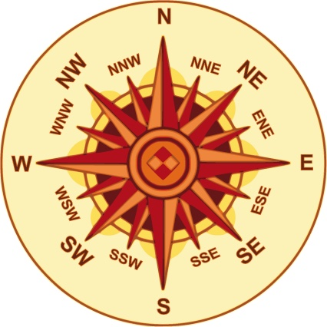
7.3
Directions on an OS Map
Directions on OS maps are given in the form of compass points.

Slide 17
7.4
Locating Places: The National Grid
Grid References on an OS Map
When locating a specific location on an OS map, grid references are used.
There are two types of grid references:
Four-figure grid references
Four-figure grid references are used to give the location of a single square on the OS map, so they give the general location of features within that square.
Six-figure grid references
Six-figure grid references are used to give the exact location of a feature within a grid square.
Instructions
For instructions on how to calculate four- and six-figure grid references, please refer to page 78 of the textbook.

Slide 18
7.5
Identifying Symbols on an OS Map
Symbols are used on an OS map to show features.
Symbols can be found on the back of OS maps in the form of a legend (or key to the map).
Book check
For a full list of OS map symbols, please refer to page 80 of the textbook.

Slide 19
7.6
Altitude (Height) on an OS Map
Altitude or height is shown in metres above sea level on an OS map. It is shown in four different ways.
Triangulation stations
These are black triangles with the altitude measurement written beside them. They can show the height of mountain peaks and can be the highest point on a map.
Land under 200 m is shown in different shades of green. Higher land is shown in shades of brown, which get darker as height increases.
Colour coding
These are lines that join places of equal height. Look for the contours with a number beside them to see the height of that area.
Contours
These are black dots with the altitude measurement written beside them. They show specific heights for places.
Spot heights

Slide 20
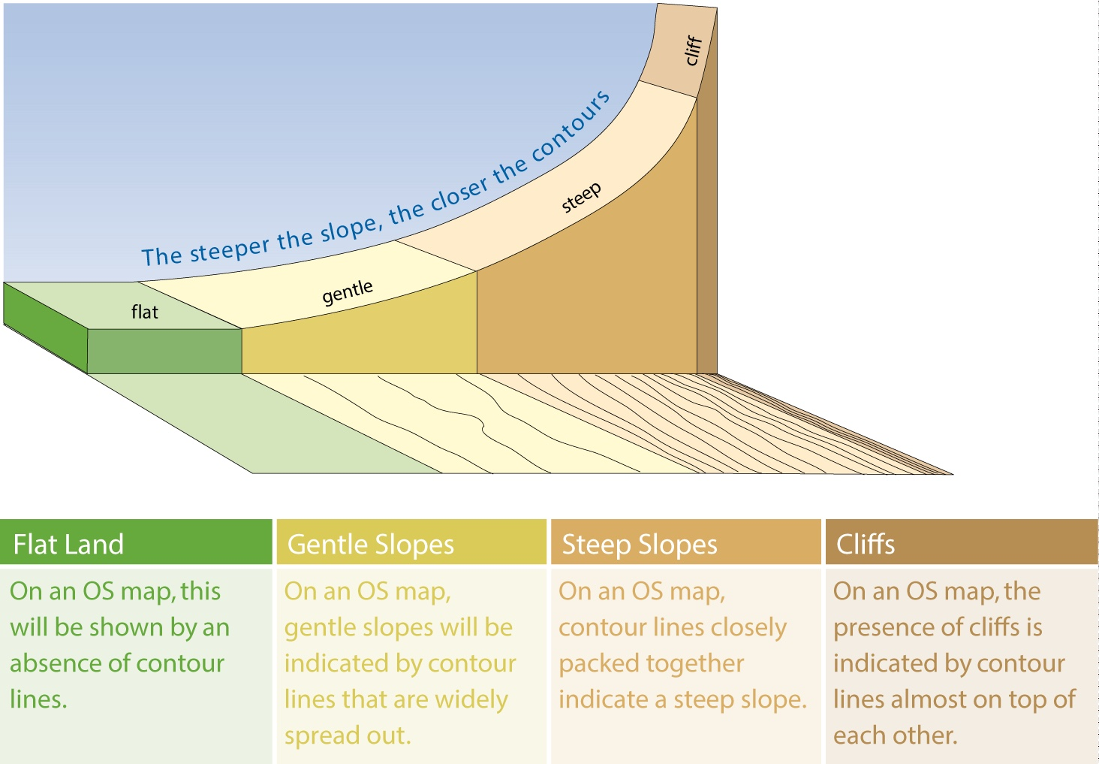
7.6
Altitude (Height) on an OS Map
Showing Slope
Slope describes the steepness of the land. The closer the contour lines on a map, the steeper the slope of the land.

Slide 21
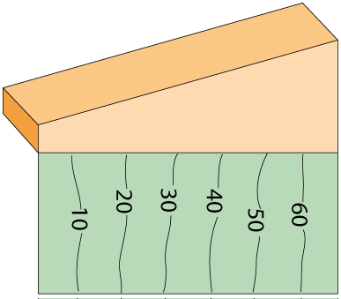
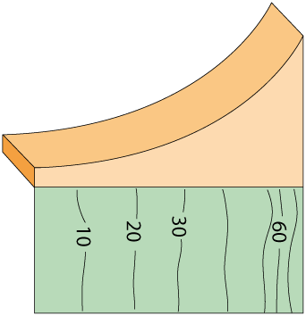
7.6
Altitude (Height) on an OS Map
Types of Slope on an OS Map
Slope | Side View
Even Slope The contours are evenly spread. The increase in steepness is gradual.
Concave Slope The contours begin by being widely spaced apart, then become closer and closer. This means the slope is gentle at first and then becomes quite steep

Slide 22
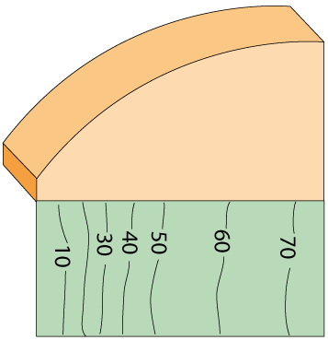
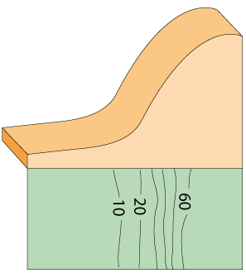
7.6
Altitude (Height) on an OS Map
Types of Slope on an OS Map
Slope | Side View
Convex Slope The contours are closely spaced at the beginning and gradually become more widely spaced at the top. The slope is very steep at its base and evens out at its peak.
Concave Slope This slope is a combination of concave and convex slopes.

Slide 23
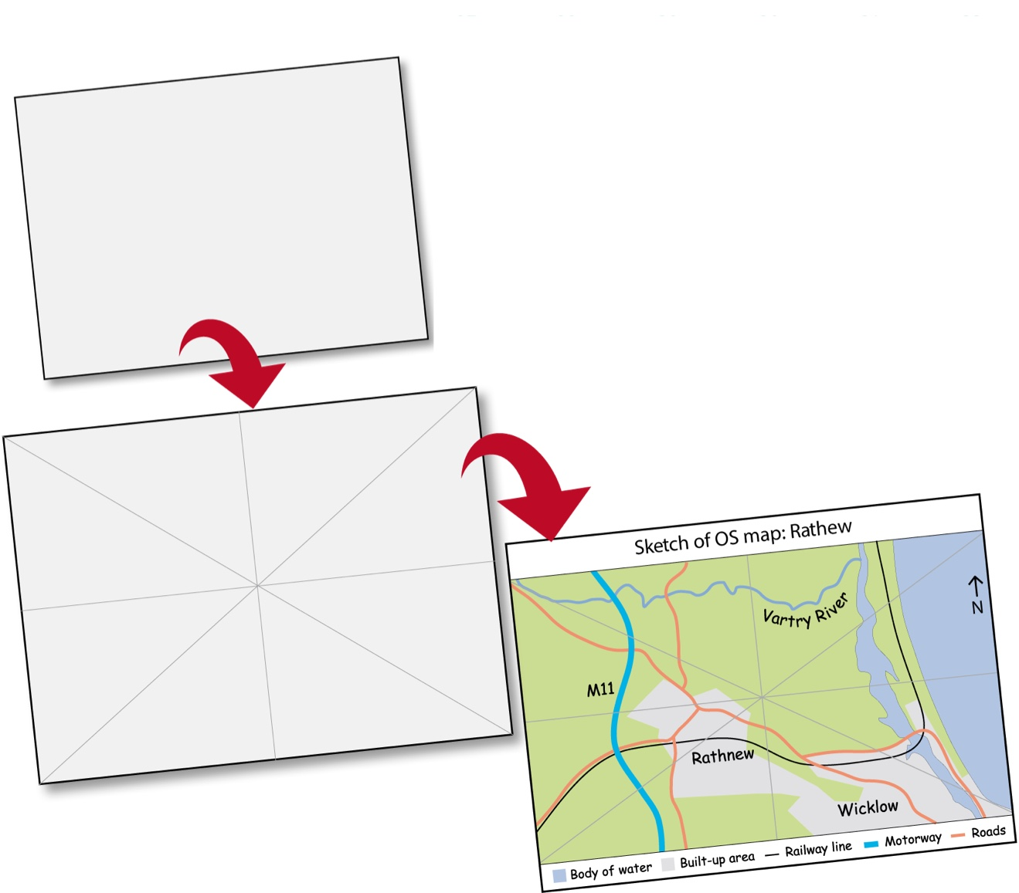
7.7
Drawing Sketch Maps
A sketch map is a hand-drawn copy of an OS map. When sketching an OS map, there are a number of guidelines to follow.
1
1
Draw a rectangular frame for the sketch as instructed.
See page 86 of the textbook for the map of Rathnew.
2
4
3
5

Slide 24
7.7
Drawing Sketch Maps
A sketch map is a hand-drawn copy of an OS map. When sketching an OS map, there are a number of guidelines to follow.
1
2
Using a pencil, lightly divide both the OS map and the sketch into segments.
2
4
3
5

Slide 25
7.7
Drawing Sketch Maps
A sketch map is a hand-drawn copy of an OS map. When sketching an OS map, there are a number of guidelines to follow.
1
3
Insert the coastline (if any) on the sketch.
Insert and name the other required features, omitting any unnecessary details. Indicate north with a direction arrow on the sketch.
2
4
3
5

Slide 26
7.7
Drawing Sketch Maps
A sketch map is a hand-drawn copy of an OS map. When sketching an OS map, there are a number of guidelines to follow.
1
4
Give the sketch a title.
2
4
3
5

Slide 27
7.7
Drawing Sketch Maps
A sketch map is a hand-drawn copy of an OS map. When sketching an OS map, there are a number of guidelines to follow.
1
5
Beside or below your sketch, you must provide a key/legend that details the key items as drawn on your sketch.
2
4
3
5

Slide 28
7.8
Reading the Physical Landscape
Relief
Relief refers to the shape of the land’s surface. There are six different relief features.
Relief Feature | Side View
Upland | Coloured yellow or brown on OS map – a large area of land over 200 metres in height.
Lowland | Coloured green on OS map – a large area of land less than 200 metres in height.
Mountain | Dark brown on OS map – a steep-sided landform that is over 400 metres in height.
Hill | A raised area of land under 400 metres.
Ridge | A long narrow upland area with steep sides.
Valley | A long and often narrow area of land usually featuring a river.

Slide 29
7.8
Reading the Physical Landscape
Drainage
Drainage refers to the way that water flows on the land’s surface. It relates to rivers, lakes and marshes.
OS maps sometimes allow us to identify places that are well-drained as well as places that are poorly drained or flooded/likely to flood.
Signs of a well-drained area
Signs of a poorly drained area
Very few areas of surface water
Lots of surface water, rivers, tributaries and even lakes
Settlements and roads
Little or no settlement
No roads close to rivers
Coniferous tree plantations, which help soak up floodwater

Slide 30
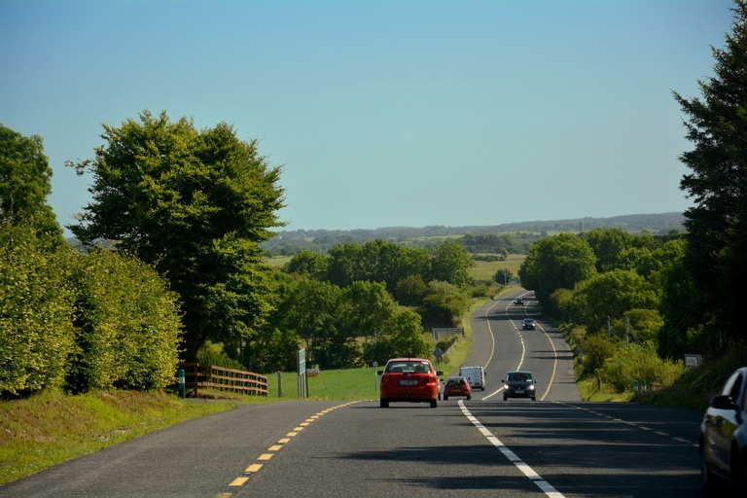

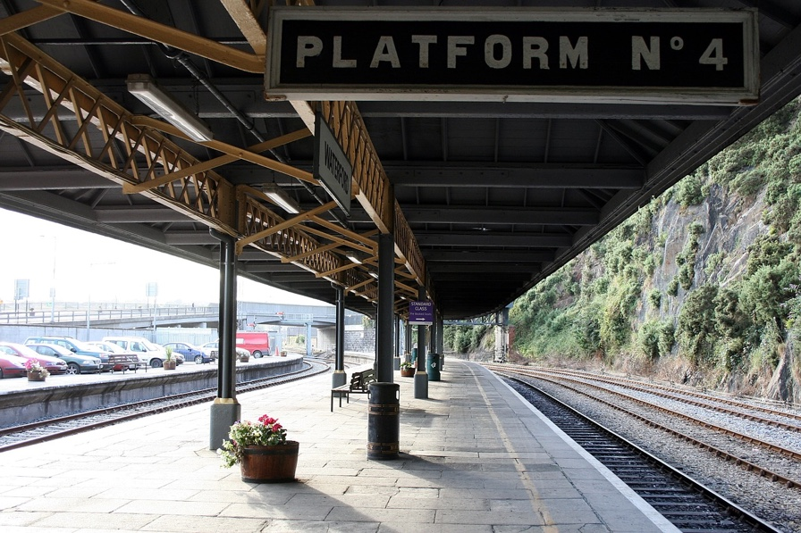
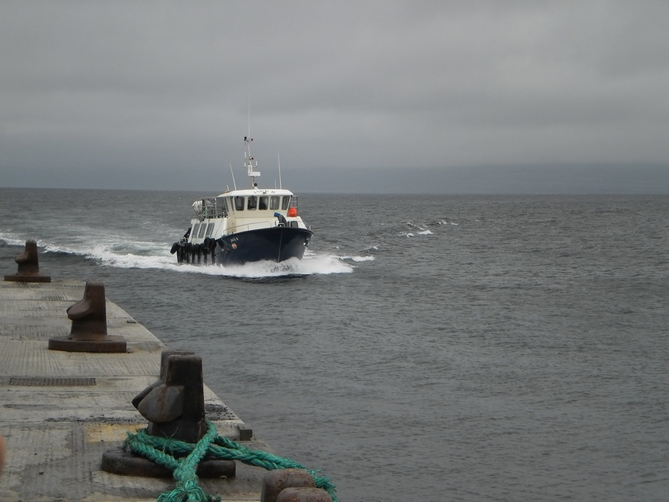
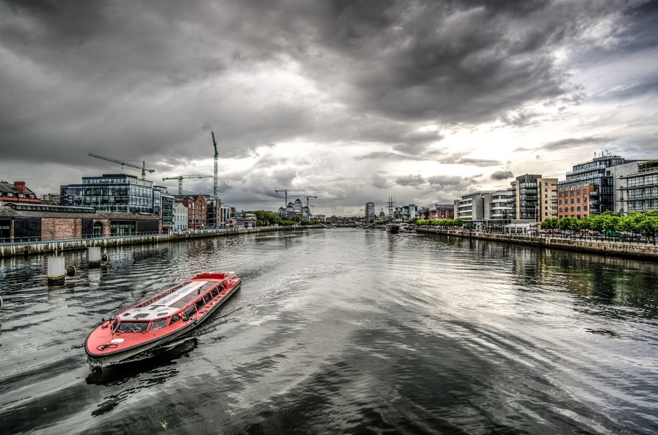
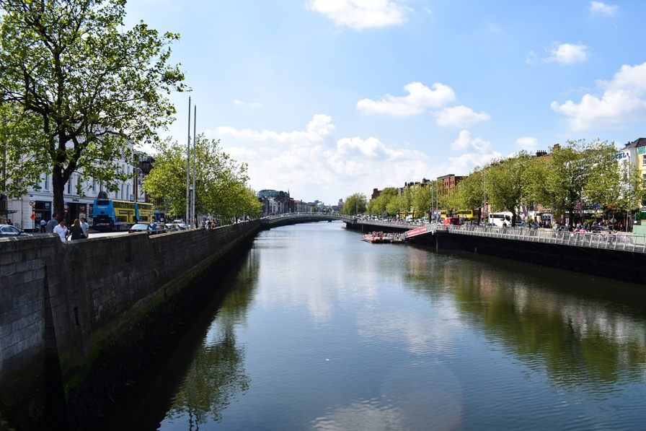
7.9
Reading the Human Landscape
Transport
In Ireland, most transport is carried out on roads.
Transport also takes place by:
Rail
Air
Sea
River
Canal
Relief and drainage can influence route ways.

Slide 31
7.10
Settlement on an OS Map
A settlement is a place where people live. There are a number of different types of settlement that can be seen on an OS map.
Former/Historic settlement | Ancient or historical sites of where humans lived
Rural settlement | Small villages and isolated houses
Urban settlement | Cities and towns
Place names | Common place names

Slide 32
7.10
Settlement on an OS Map
Rural Settlement
There are a number of factors that affect the density (the amount of settlement) and location of rural settlement.
Altitude | Most human settlement is found on land below 200 m (coloured green on OS maps). Land above that is often too cold, wet and windy to live on.
Slope | Most building is done on flat or gently-sloping land. Farming is also easier on this type of land.
Aspect | This refers to the direction in which the slope faces. South- facing slopes receive more sun and therefore are preferable for settlement.
Drainage | Well-drained land is better for settlement. Marshes or rivers that are prone to flood are avoided where possible.

Slide 33
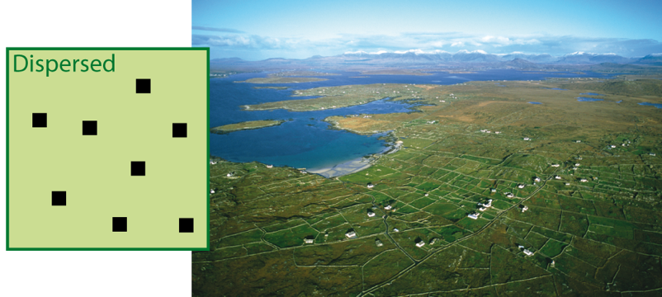
7.10
Settlement on an OS Map
Rural Settlement Patterns
Settlement patterns means the general way or shape that houses are distributed on an OS map. Rural settlement patterns generally have three patterns.
Dispersed settlement patterns will have houses isolated or spread around the countryside.
They may be farm buildings surrounded by farmland.

Slide 34
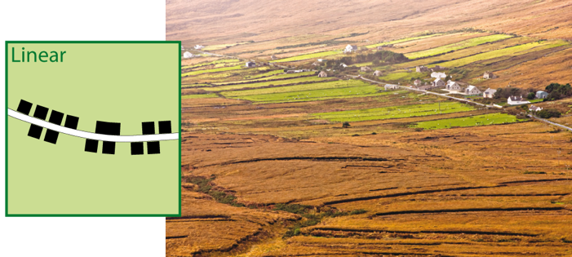
7.10
Settlement on an OS Map
Rural Settlement Patterns
Settlement patterns means the general way or shape that houses are distributed on an OS map. Rural settlement patterns generally have three patterns.
Linear settlement patterns (also called ‘ribbon’ settlement) represent buildings that follow a road or coastline in a direct style.
They can also be found at the foot of steep hills.

Slide 35
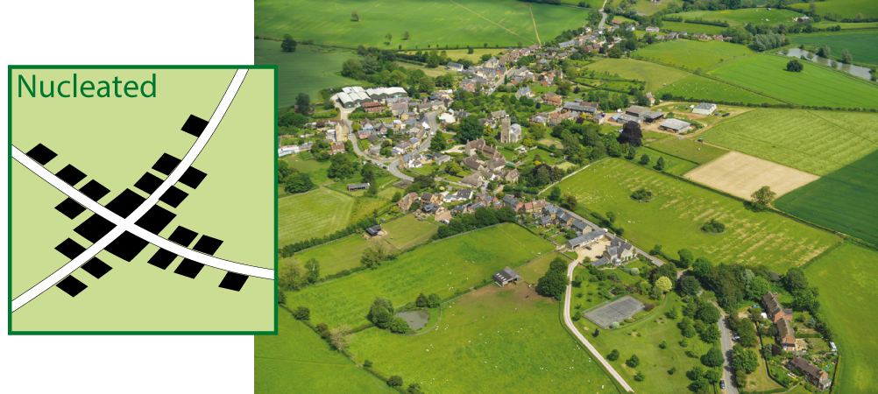
7.10
Settlement on an OS Map
Rural Settlement Patterns
Settlement patterns means the general way or shape that houses are distributed on an OS map. Rural settlement patterns generally have three patterns.
Nucleated settlement patterns are buildings grouped together.
This can mean houses grouped at crossroads, at cul de sacs or in villages.

Slide 36
7.10
Settlement on an OS Map
Urban Settlement
Urban settlement refers to settlement in towns and cities. There are a number of factors that influence the location of urban settlement.
Flat or gently-sloping land | Flat or gently-sloping land is favourable for the construction of buildings and roads.
Where transport routes (road, rail, other) meet | Villages, town and cities can develop at the point where transport routes meet. These are called nodal points or route focus points. These types of places may encourage the development of trade.
Bridging points on rivers | In the past, bridges were very expensive to construct so roads would converge where one existed. This made areas surrounding bridges attractive locations to begin settlement.
Coastal locations | Ports developed at settlement points along the coast to allow trading. This can provide jobs and encourage further settlement.

Slide 37

Video: Mapping the World – Analyzing Historical Sketch Maps
Notes:
Note to Teacher: You may have to log into your GillExplore account in order to watch this video.

Slide 38
Video: Mapping the World – Measuring Distances with a Map or Globe
Notes:
Note to Teacher: You may have to log into your GillExplore account in order to watch this video.

